Slide 1

Class 1A: Apologetics Can Change Your Life

Slide 2

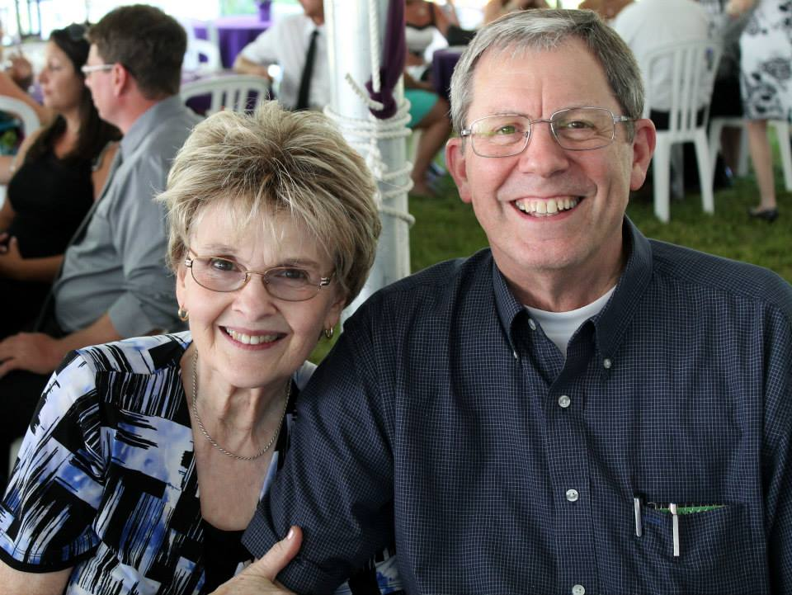
Apologetics Can Change Your Life: Class 1A
Introduction to Apologetics
Confident growth in the Christian faith.

Slide 3

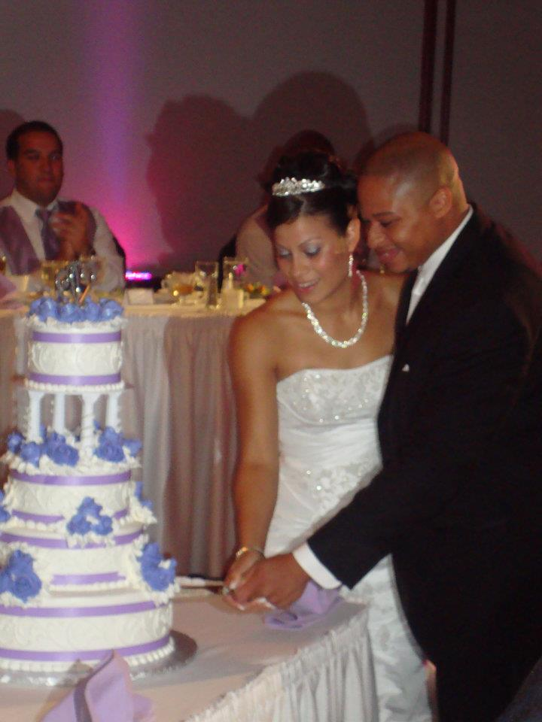
Confident growth as a Christian to share Christ with others.

Slide 4
1). Dr. Norman Geisler's definition of apologetics:
“It's opening the door, clearing the rubble,
and getting rid of the hurdles,
so people can come to Christ.”

Slide 5
Positive:
Helps people see the need for Jesus.
Negative::
Often we have to go on the defense to answer questions.

Slide 6
2. A major challenge in the East and our world to Christian values:
Islam: Submit
They teach-
Jesus didn’t die on the cross.
Jesus is not God.
Deny Trinity

Slide 7
3). The Bible’s answer to the challenges we face as Christians:
Philippians 1:7 – Gk. “Apologia” which means to give an answer, or, a defense.

Slide 8
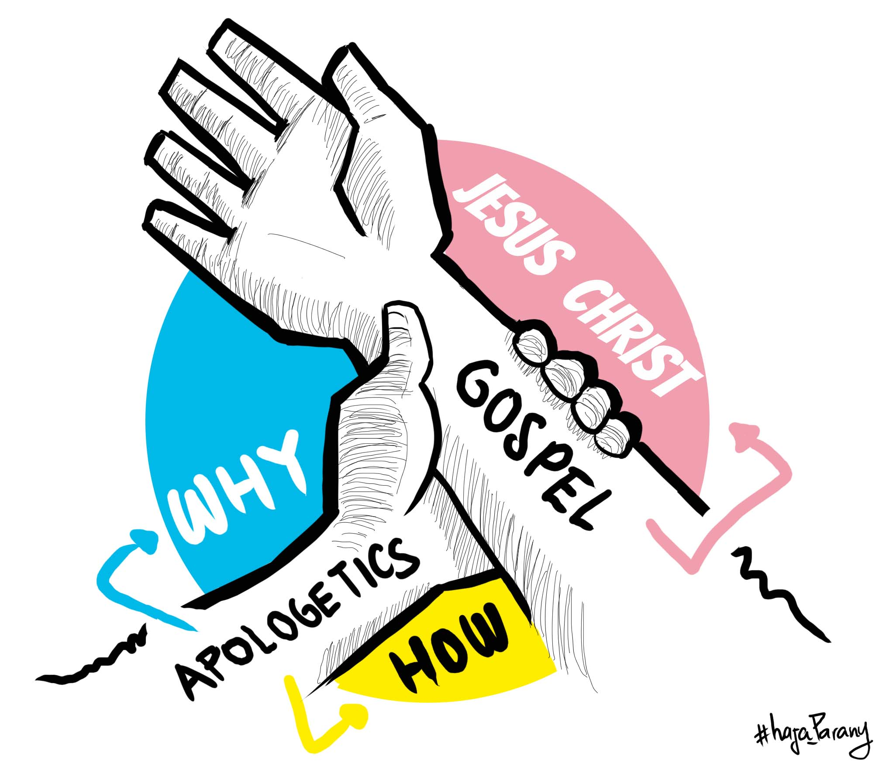

Slide 9
1 Peter 3:15 – An Answer, (Defense), “Apologia””. “...with respect”

Slide 10
Lordship:
The Need to Talk
With gentleness and respect”. “...with respect”

Slide 11
4).
5). Apologetics and Spiritual Warfare:
It is not just humans and God that exist. We have an enemy.
Satan's strategy is clearly seen in the book of Genesis 3:1-5.

Slide 12
Satan's strategy is clearly seen in the
book of Genesis 3:1-5:
1). Started with an idea.
2). Challenged the Word of God.
3). Spiritual warfare begins as the battle
of ideas.

Slide 13
How the devil murders:
By having people believe a lie, he has
murdered them for all eternity
Ephesians 4:13-15

Slide 14
How does apologetics then help conquer spiritual warfare?
Apologetics replaces lies with the truth!
Ephesians 4:13-15

